Slide 1
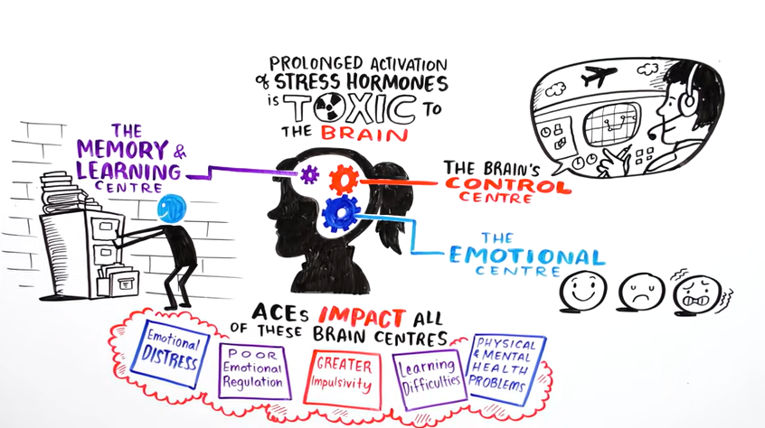

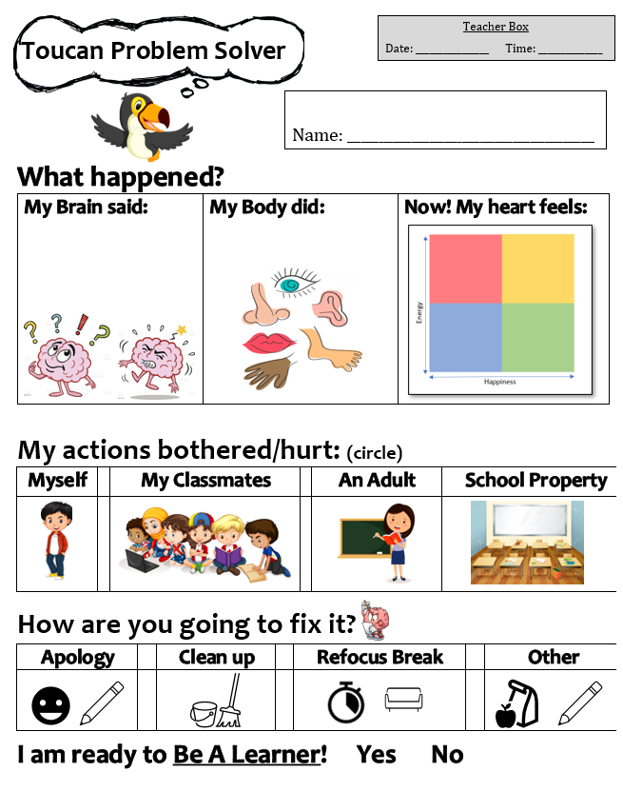
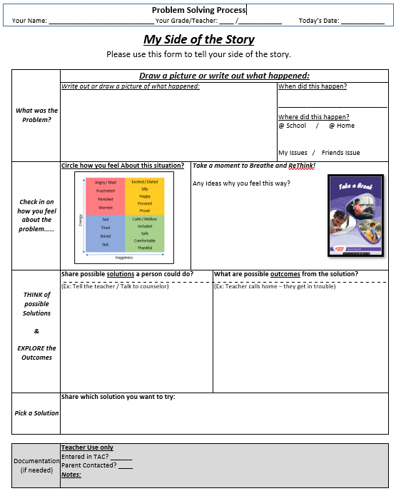
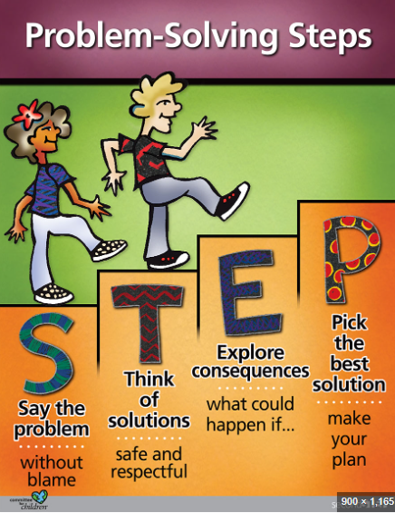
Repair ~ Restore
Second Step
Curriculum to Specifically Teach the SKILLS
Done over years with targeted progression to meet developmental learning levels!
Notes:
Punishment vs Discipline (natural consequences)
when safety is an concern
natural consequences with guided support
Communication – link back to relationships – focus on the emotion not the behavior “ I know you were frustrated, but we not have to pick up the mess. I can work with you or do you want to do it yourself.
Address Time: fuels the fuel cycle

Slide 2
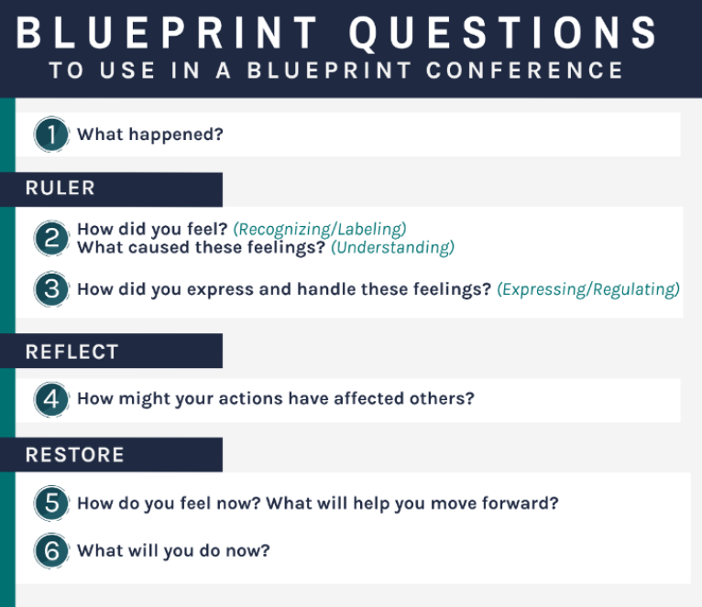
Repair ~ Restore
The Blueprint (RULER)
Strategy
Healing Focused strategy designed to guide students through an Effective problem-solving process
Notes:
Punishment vs Discipline (natural consequences)
when safety is an concern
natural consequences with guided support
Communication – link back to relationships – focus on the emotion not the behavior “ I know you were frustrated, but we not have to pick up the mess. I can work with you or do you want to do it yourself.
Address Time: fuels the fuel cycle

Slide 3
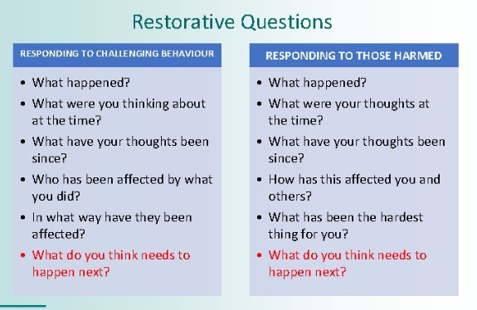
Repair ~ Restore
The Blueprint (RULER)
Restorative Practices
Personal Action
1-2 things you can shift next year to ENSURE we repair after times of confusion, frustration, or hurt…..
Notes:
Punishment vs Discipline (natural consequences)
when safety is an concern
natural consequences with guided support
Communication – link back to relationships – focus on the emotion not the behavior “ I know you were frustrated, but we not have to pick up the mess. I can work with you or do you want to do it yourself.
Address Time: fuels the fuel cycle

Slide 4
Summary
Second Step
The Blueprint (RULER)
Curriculum to Specifically Teach the SKILLS
Strategy
Notes:
Punishment vs Discipline (natural consequences)
when safety is an concern
natural consequences with guided support
Communication – link back to relationships – focus on the emotion not the behavior “ I know you were frustrated, but we not have to pick up the mess. I can work with you or do you want to do it yourself.
Address Time: fuels the fuel cycle

